Slide 1

SARANATHAN COLLEGE OF ENGINEERING
(An Autonomous Institution)
Venkateswara Nagar, Panjappur,
Tiruchirappalli - 620 012, Tamil Nadu.
Department of Computer Science and Engineering
CS3811 – Project Work
E-AUTHENTICATION USING OTP AND QR CODE FOR ONLINE VOTING SYSTEM
Submitted by :
PRADEEP KUMAR M 813821104070
PRAGADEESHWARAN S 813821104071
RANJITH M 813821104307
VIGNESH K 813821104308
Guide Name :
Ms.G.Sathya, M.E

Slide 2
ABSTRACT
The E-Authentication using OTP and QR for Online Voting System enhances election security by using email verification, QR code authentication, and OTP-based login. Built with PHP and MySQL, it ensures secure voter registration, unique voter identification with MD5-based QR codes, and safe OTP delivery through PHPMailer. The system prevents multiple voting by updating voter status and protects data through encryption and session management. The admin panel helps manage parties and monitor elections. With a user-friendly interface and multi-layer security, the platform ensures a reliable, fair, and transparent online voting process.

Slide 3
BASE PAPER
TITLE: S Ganesh Prabhu, “Smart Online Voting System,” in International Journal of Advanced Research in Computer Science, 10(3), pp. 55 59, IEEE, 2021
WEBSITE: https://ieeexplore.ieee.org/document/9441818
DOI: 10.1109/ICACCS51430.2021

Slide 4
OBJECTIVES
Design a secure and efficient E-authentication system for online voting using OTP and QR verification.
Key goals include:
To provide a secure and efficient online voting platform.
To implement multi-factor authentication (email verification, QR code, OTP) for enhanced voter security.
To prevent fraudulent voting through QR code verification.
To ensure easy election management with an admin module for party control.
To improve accessibility and transparency in the voting process.
Goal: Enhance integrity, transparency, and accessibility for a reliable and fraud-resistant online voting process.

Slide 5
INTRODUCTION
Builds a secure, efficient, and user-friendly online voting system.
Uses multi-factor authentication (OTP and QR code) for voter identity verification.
Developed using PHP and MySQL for secure data handling and real-time vote tracking.
Voters verify identity through email OTP and QR code scanning.
Ensures only legitimate users can cast a vote once.
Promotes transparency, security, and accessibility in elections.
Provides a fraud-resistant digital voting solution.

Slide 6
LITERATURE SURVEY
YEAR | AUTHOR NAME | TITLE | TECHNIQUES | MERITS | DEMERITS
2024 | Harshil Kanakia | Secure Authentication Via Encrypted QR Code | Encrypted QR Code,OTP-based Verification | secure client-to-client communication system using encrypted QR codes and OTPs | Specific author details are not provided; the study focuses on client-to-client communication
2022 | V. Patel & R. Sharma | A Study on Multi-Factor Authentication in Online Voting | OTP-based authentication, Biometric Verification, QR Codes | Provides a comparative analysis of different authentication techniques used in online voting systems. | Focuses on theoretical analysis; lacks real-time system implementation.
2021 | K. Balaetal | Smart Online Voting System | OTP-based authentication, Face Recognition | Proposed a secure online voting system using OTP and face recognition to verify voter identity. | Dependency on facial recognition may cause accessibility issues for users without proper cameras.

Slide 7
LITERATURE SURVEY
YEAR | AUTHOR NAME | TITLE | TECHNIQUES | MERITS | DEMERITS
2019 | J. Lee & H. Kim | A QR Code-Based Authentication System for Secure Transactions | QR Code Authentication, Multi-Factor Authentication (MFA) | Demonstrates the use of QR codes as an additional layer of security for user authentication. | QR codes alone are insufficient; additional security mechanisms (OTP, PIN) are required.
2010 | T. Anitha | An Online Voting System Using Biometric and OTP Authentication | OTP-based verification | Relatively Quick | increasing complexity and deployment costs.

Slide 8
PROBLEM DEFINITION
Traditional voting systems face challenges such as long queues, voter impersonation, security risks, and limited accessibility for remote voters. Existing online voting platforms often lack strong authentication measures, making them vulnerable to fraud, multiple voting attempts, and cyberattacks. Additionally, maintaining voter anonymity while ensuring secure and accurate vote tracking is a major concern.
This project, E-Authentication Using OTP and QR for Online Voting System, addresses these issues by implementing multi-factor authentication (OTP + QR code), secure data storage, and real-time monitoring to provide a transparent, reliable, and tamper-proof online voting solution.

Slide 9
PROPOSED SOLUTION
The proposed system, E-Authentication using OTP and QR for Online Voting, provides a secure, remote, and efficient platform for online elections by integrating multi-factor authentication methods. Voter identity is verified first through an OTP sent to their registered email, followed by QR code authentication during voting. Each voter receives a unique, one-time usable QR code, ensuring that votes are cast only once and eliminating impersonation risks. The backend system, developed using PHP and MySQL, securely manages voter details, authentication logs, and voting records. Real-time monitoring, secure session handling, and an Intruder Capture & Alert System (ICAS) are implemented to prevent unauthorized access attempts. This approach ensures a transparent, tamper-proof, and accessible voting process, reducing election fraud and increasing voter participation.

Slide 10
ARCHITECTURE DIAGRAM
Start
No Yes
User Details
Registered
User Database
Login
Email Verified?
Email Verification
Yes
Login Successful?
Generate OTP & QR code
Yes
Signup
Authentication Via
QR code
Cast Vote
Vote Successful
End
End
End

Slide 11
PROPOSED SYSTEM DESIGN
SYSTEM ARCHITECTURE
The E-Authentication Online Voting System is a secure and intelligent design combining authentication,
voting,and monitoring technologies for integrity and safety.
INPUT SUBSYSTEMS
Users input data through registration and login forms.
Mobile numbers and emails are used for OTP (One-Time Password) generation and verification.
QR codes are generated uniquely for each voter using MD5 encryption.
PROCESSING SYSTEM
Data is processed using a PHP backend connected to a MySQL database.
User identity is verified through OTP and QR code, with secure recording of one vote per user.

Slide 12
PROPOSED SYSTEM DESIGN
CONTROL SYSTEM
The system verifies user authentication using OTP and QR code.
It prevents voting if authentication fails.After three failed login attempts, the system captures a webcam image and triggers a security alert.
ALERT AND NOTIFICATION SYSTEM
On detecting multiple failed logins, an alert email is sent to the registered voter with the captured image.
Successful vote submission also triggers a confirmation email.
OUTPUT SUBSYSTEMS
Outputs include OTP generation and QR code display for voter authentication.
Voting dashboard shows real-time voting status and login activity.

Slide 13
MODULES
1. REGISTRATION MODULE
Users register by providing their details.
Email verification is done via OTP.
A unique QR code is generated and sent to the user
2. LOGIN MODULE
Users log in using their registered email and password.
OTP verification is required after entering credentials.
3. VOTE CASTING MODULE
Voters scan their QR code to authenticate.
Ensures each voter can vote only once.
Allows selection of a political party.

Slide 14
MODULES
4. ADMIN MODULE
Admin manages political parties and monitors voting activities.
Admin can add, update, or delete political parties.
Tracks voter participation and generates election reports.
5. INTRUDER CAPTURE AND ALERT SYSTEM (ICAS) MODULE
Detects multiple failed login attempts.
Sends an alert email with the captured image to the rightful user.
Captures an image using the device camera after 3 failed tries.

Slide 15
HARDWARE REQUIRMENTS
SYSTEM REQUIREMENTS
Process CPU – 8 Core Intel I5 or Ryzen 7 CPU.
Hard Disk Capacity – 50 GB SSD.
RAM – 8 GB of RAM.
5Mbps of Network Bandwidth.
Browser Support to Access the Website.
SOFTWARE REQUIRMENTS
Frontend Requirements
HTML, CSS, JavaScript – For user interface design and responsiveness.
Backend Requirements
PHP – For server-side logic, authentication, OTP generation, and QRcode.
MySQL – For storing user details, authentication logs, and voting records.

Slide 16
FEATURES
One-Time Voting Restriction: Prevents multiple voting by marking used QR codes and updating voter status.
Intruder Detection (ICAS Module): Captures an image of the intruder after multiple failed login attempts and sends an alert email.
Real-Time Security Monitoring: Tracks login attempts, detects suspicious activities, and alerts users and admins.
User-Friendly Interface: Voters can easily register, log in, authenticate, and cast their votes through a simple web interface.
Remote Voting Accessibility: Enables voters to participate in elections from any location without visiting polling stations.
Vote Confidentiality: Votes are kept confidential and tamper-proof through encryption and secure handling.

Slide 17
EXPECTED OUTCOMES
Secure Voter Authentication: Only legitimate, registered voters can access the voting system through OTP and QR code verification.
Prevention of Fraudulent Voting: One-time QR codes ensure that each voter can cast only one vote, preventing multiple voting attempts.
Enhanced Election Integrity: Real-time monitoring, encryption, and intruder detection ensure secure and trustworthy elections.
Increased Voter Convenience: Voters can securely cast their votes remotely without the need of visit polling stations.
Tamper-Proof Voting Process: QR code-based one-time voting and backend encryption safeguard the votes against tampering.
Reduction in Manual Errors: Automation of registration, authentication, voting, and results reduces human errors.

Slide 18
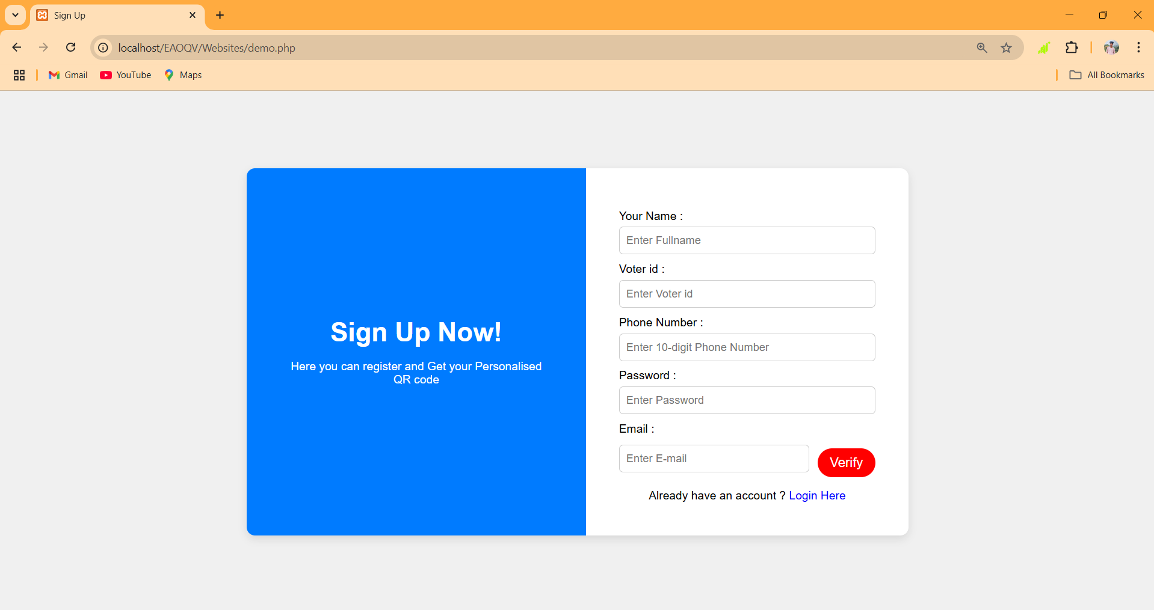
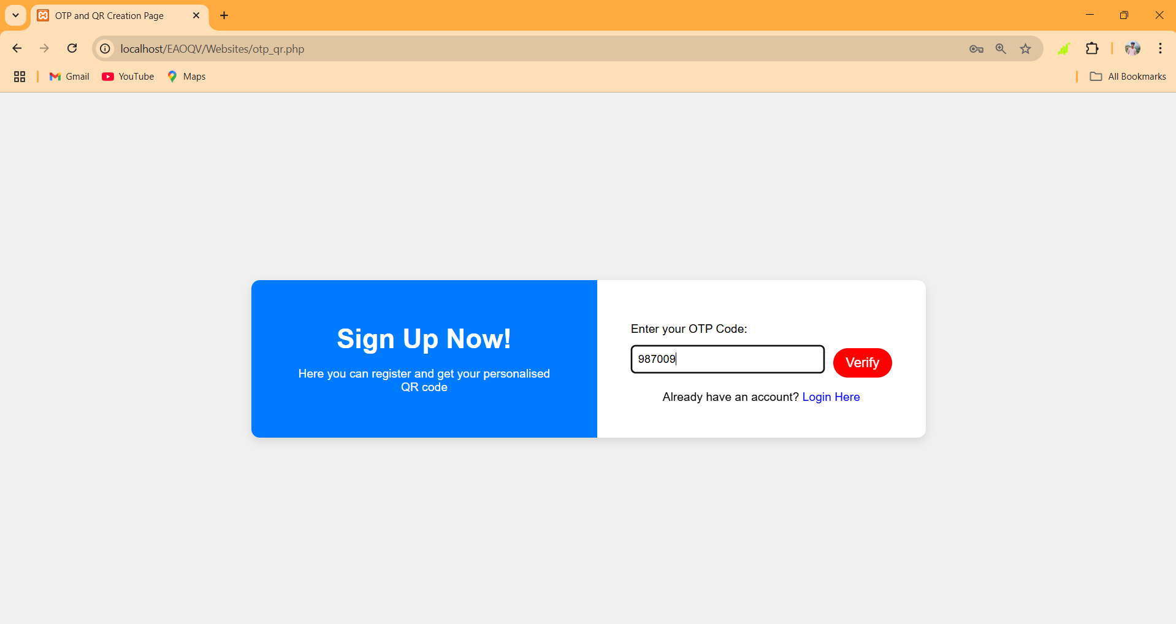
RESULT
Registration page
OTP validation page

Slide 19
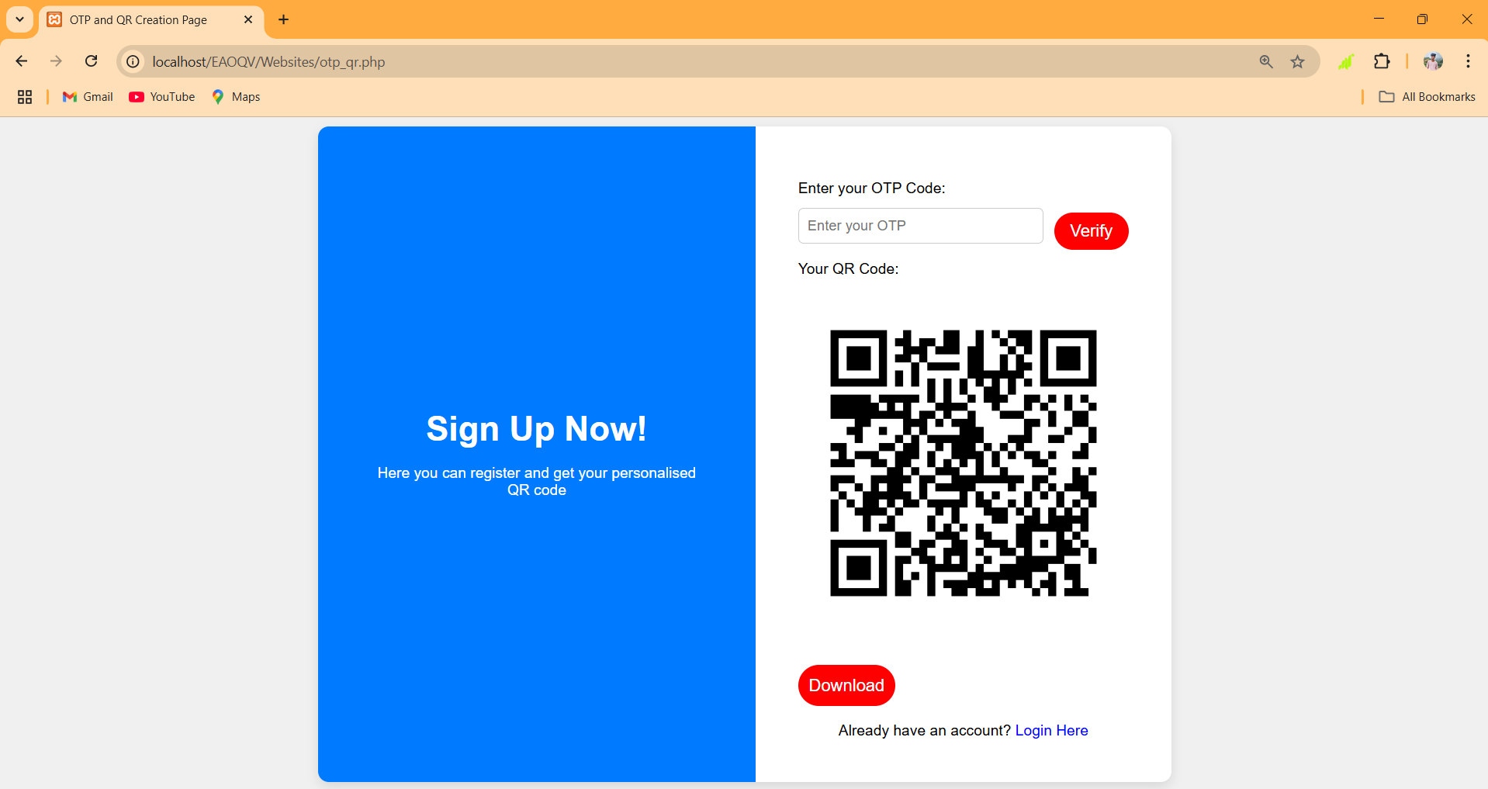
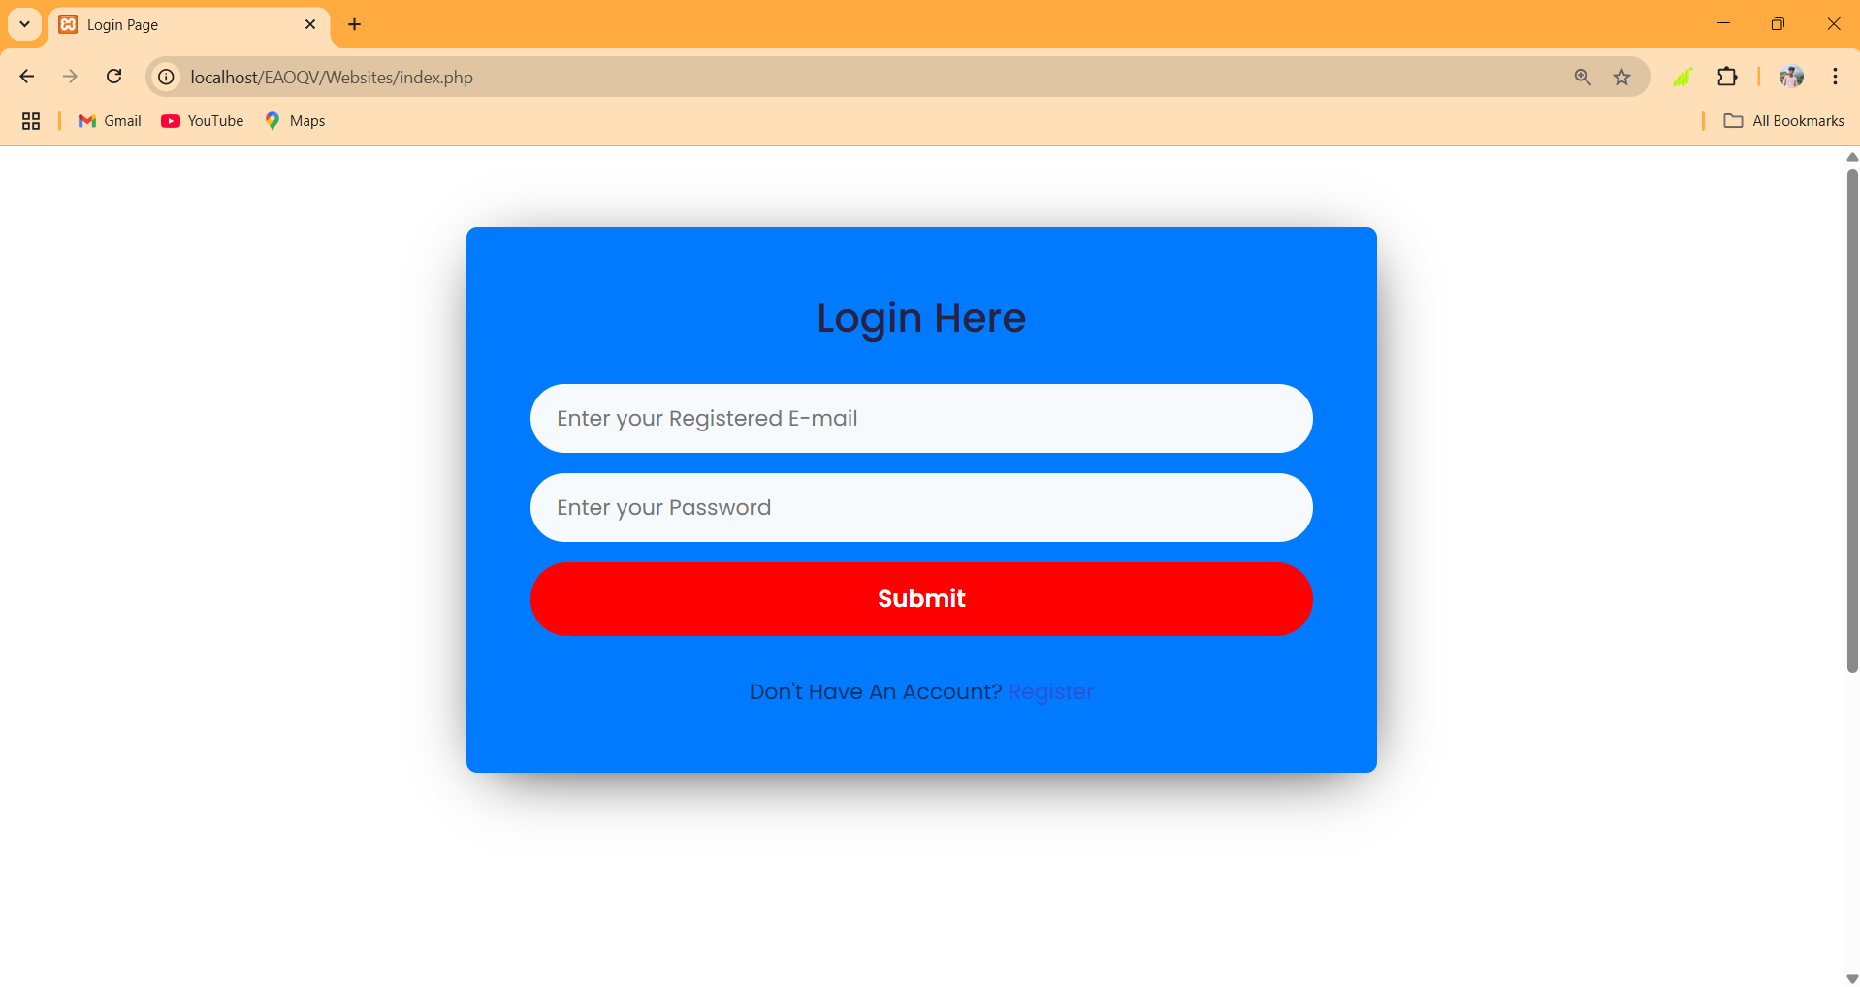
RESULT
QR generation page
Login page

Slide 20
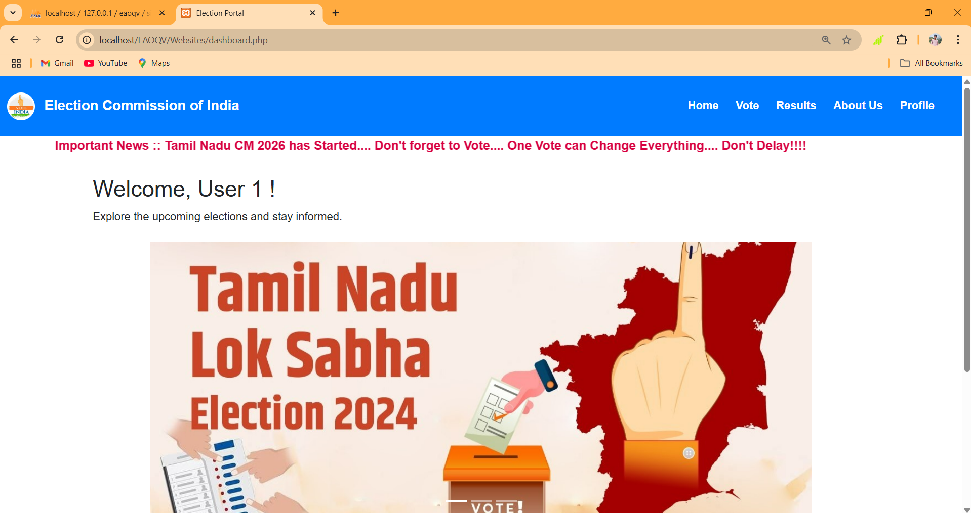
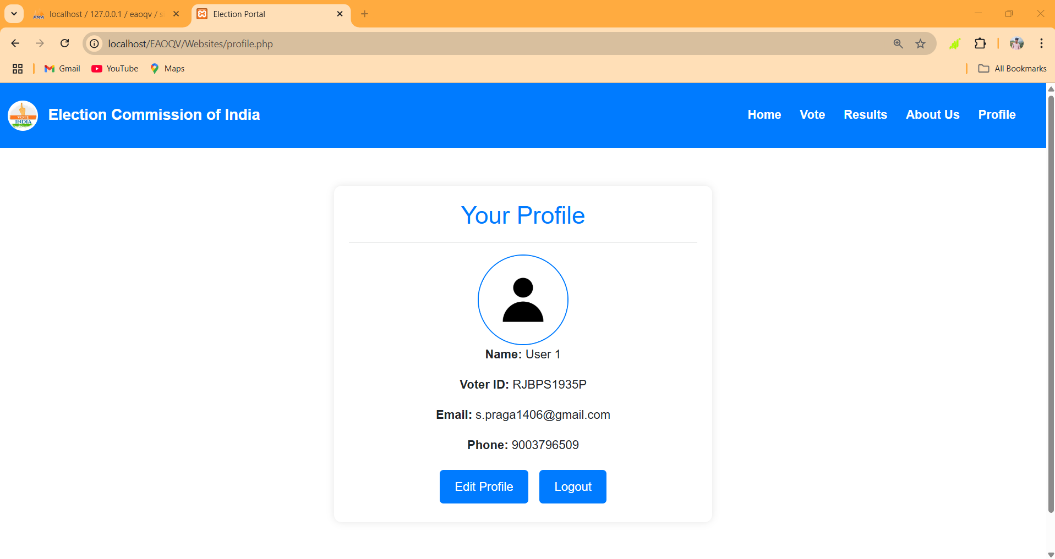
RESULT
User Dashboard Page
Profile page

Slide 21
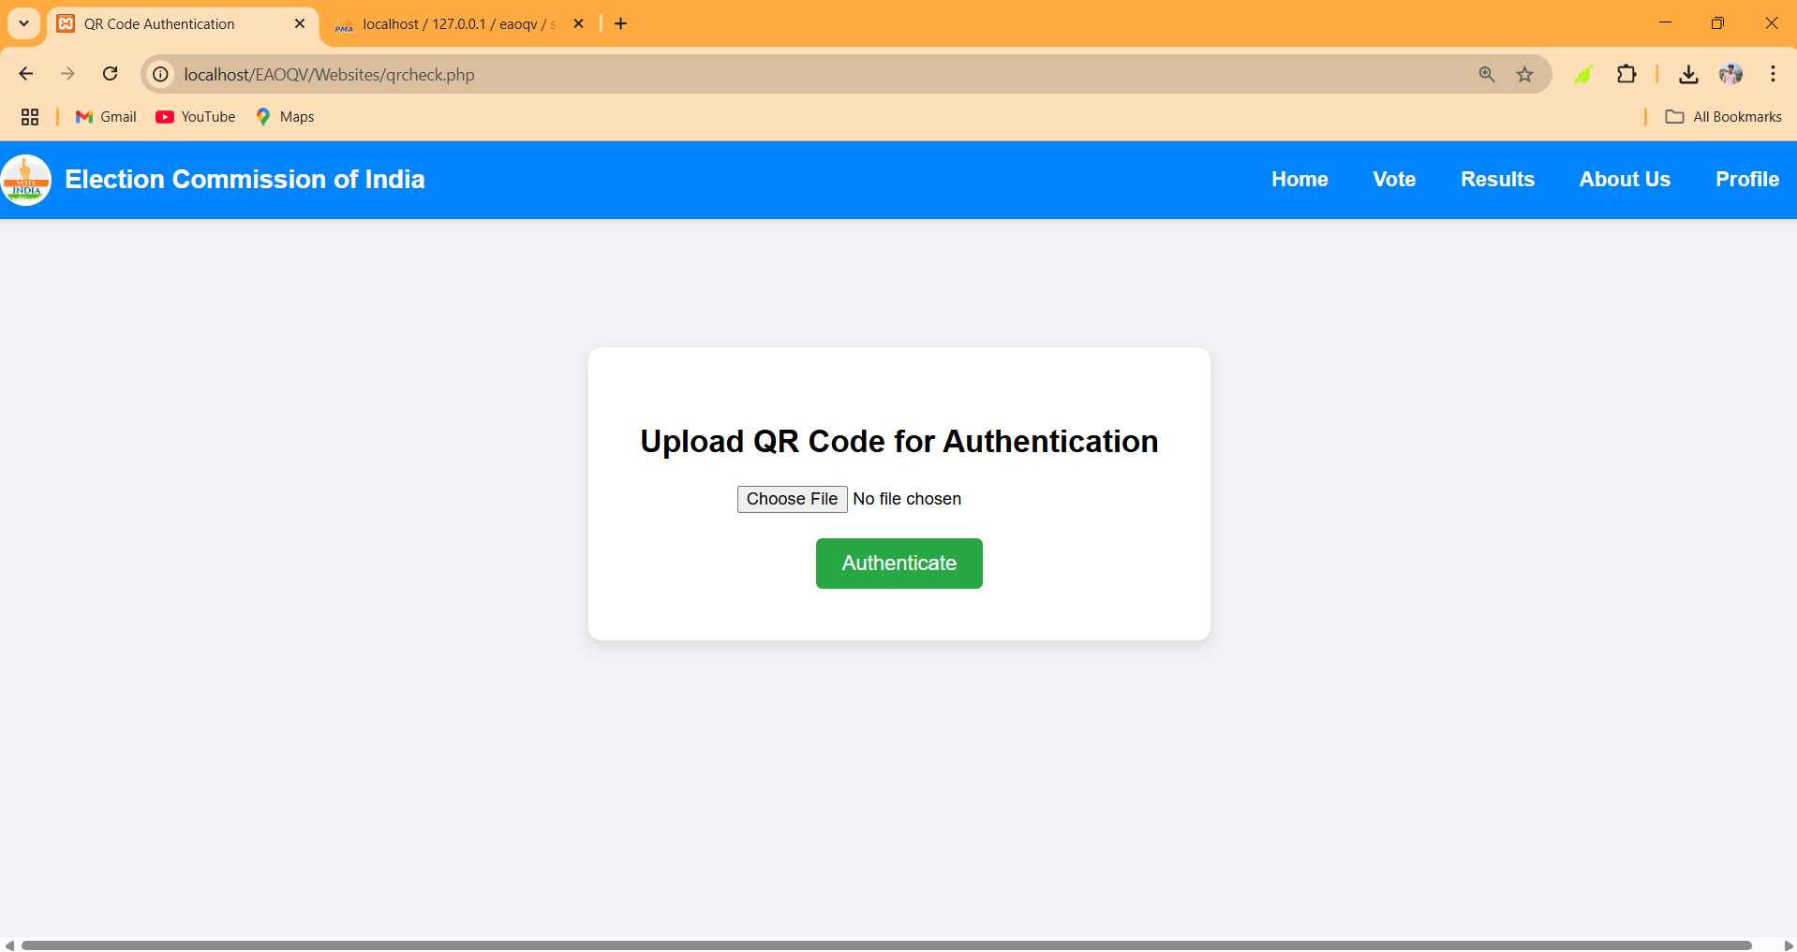
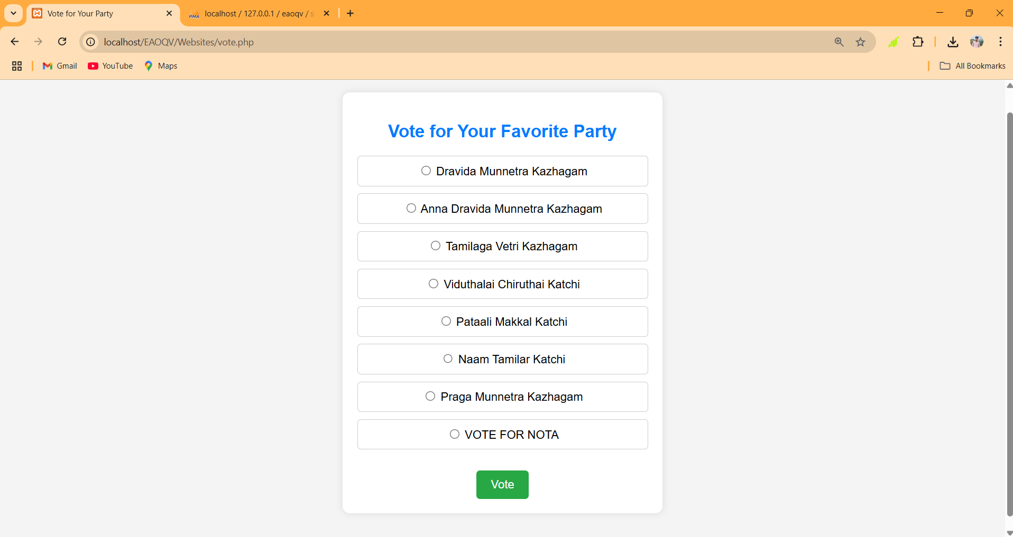
RESULT
QR authentication page
Vote party selection page

Slide 22
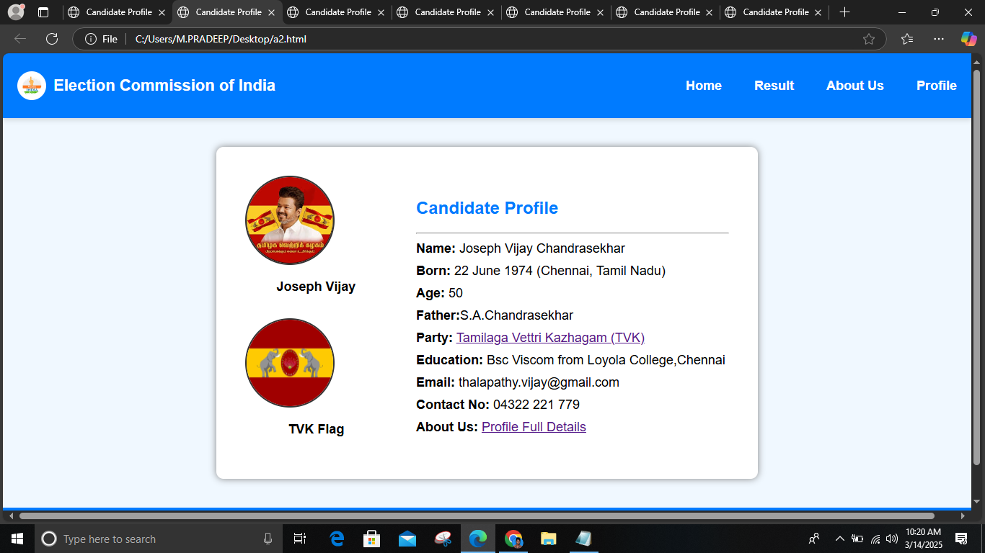
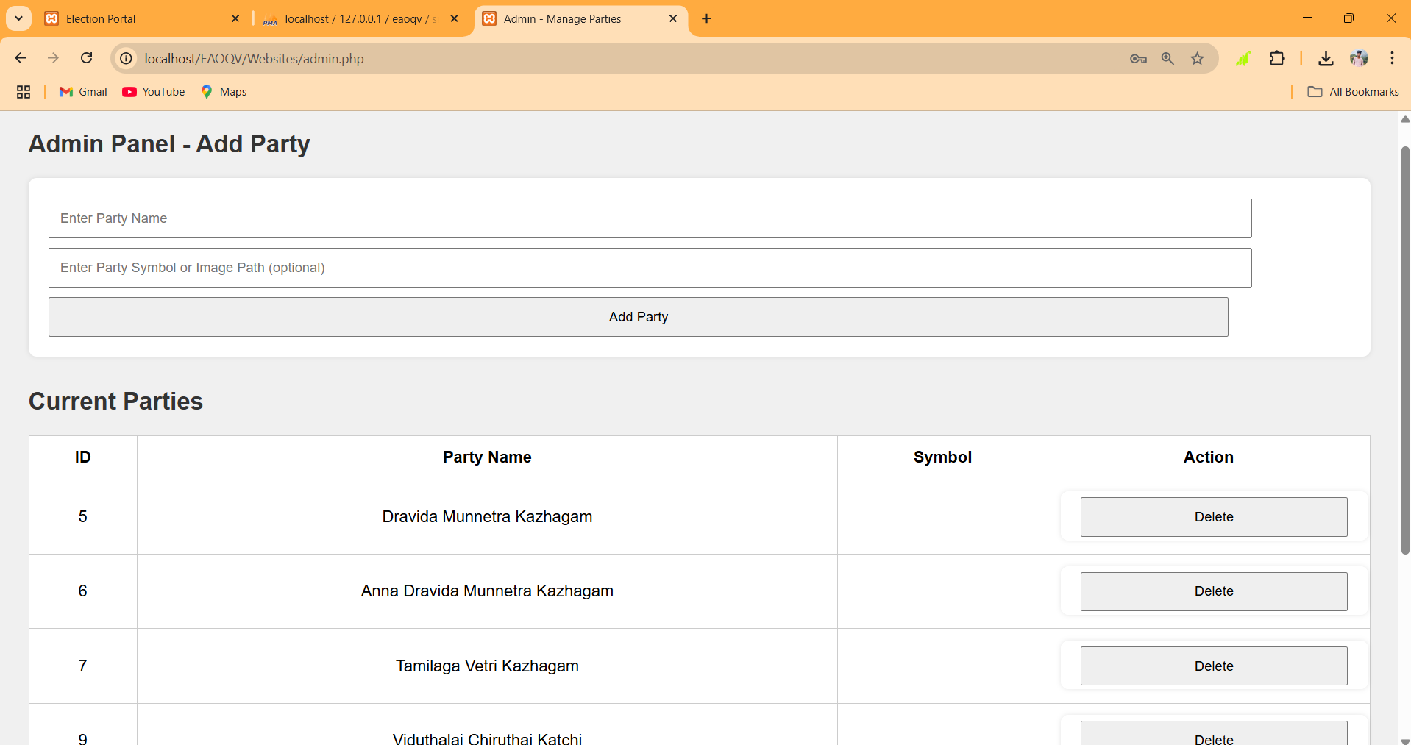
RESULT
Vote party selection page
Admin module page

Slide 23
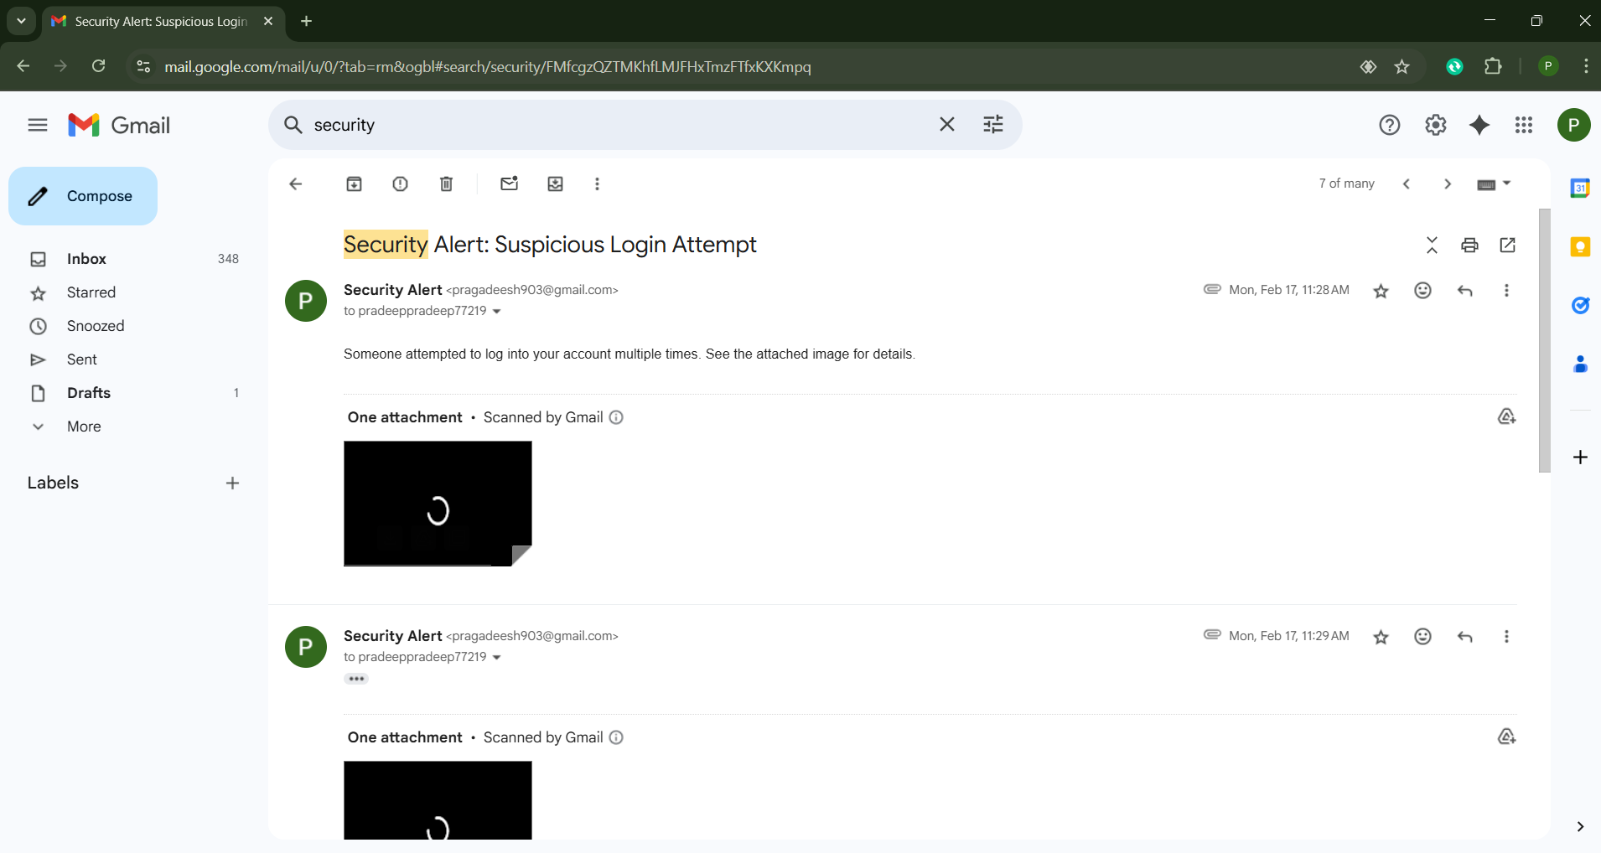
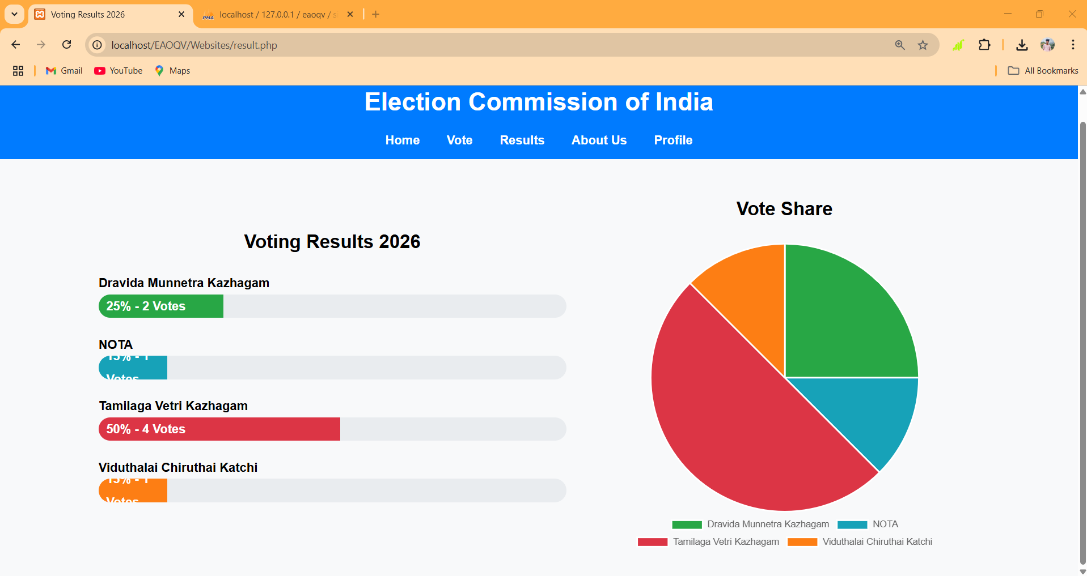
RESULT
Suspicious Login Alert Message
Result page

Slide 24
CONCLUSION
The E-Authentication Using OTP and QR Code for Online Voting System ensures a secure and transparent voting process by integrating multi-factor authentication. Using OTP verification and one-time QR codes, it prevents unauthorized access and fraudulent voting attempts. Real-time security features like intruder detection further strengthen the system. The PHP-MySQL backend efficiently manages user data and vote tracking, offering a seamless and safe voting experience. By making remote voting more accessible and reliable, the project represents a major step forward in building secure and modern online election systems, with scope for future enhancements like biometric and blockchain integration.

Slide 25
REFERENCES
[1] Patel V, "Design of secure e-voting portal with OTP-based verification and QR validation," J. Emerging Technologies and Innovative Research, vol. 9, no. 3, pp. 142–148, 2022.
[2] Das P and Sinha R, "A secure and user-friendly e-voting system using biometric and OTP with QR verification," in 2021 Int. Conf. on Intelligent Communication Technologies and Virtual Mobile Networks (IEEE), pp. 256–262.
[3] Singh N and Verma S, "QR Code and OTP based secure e-voting mechanism," in Proc. IEEE Int. Conf. on Cybersecurity and Digital Forensics, 2021, pp. 150–155.
[4] Khan S A and Islam M R, "Secure mobile voting with OTP authentication and QR code verification," IEEE Access, vol. 9, pp. 19845–19852, 2021.
[5] Kumar P and Raj M, "Enhancing security in electronic voting using blockchain and biometric-QR authentication," in Proc. Int. Conf. on Computing, Communication and Security (IEEE), 2020, pp. 84–89.

Slide 26
THANK YOU

